Slide 1

Form-Mate
Group Members
Ubaid ur Rehman (22P-9004)
Sarmad Khan (22P-9009)
Bilal Farooq(22P-9288)
Project Supervisor
Dr. Omer Usman

Slide 2


Introduction
What is Form-Mate?
Need of Project?

Slide 3



Motivation
Workload Reduction
Instant Decision

Slide 4



Problems
Slow Processing
Lack of coordination
Poor Tracking
High Operational Cost
And many more…

Slide 5



Solution
Form-Mate ( automated system )
Green AI principles
Tracking and Security
Faster Processing
Adaptive decisions

Slide 6


Scope
Form Processing
Multi-Agent Collaboration
Decision Support System
Database Integration
Error Handling and Security

Slide 7



Goals
Provide Automated System
Reduce Workload
AI Driven Campus
Fast and Reliable Processing

Slide 8

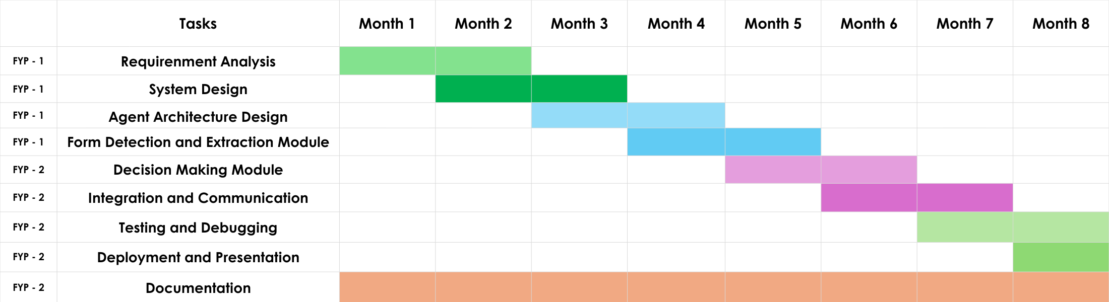
Objectives

Slide 9


Expected Result
Automated Form Management System
Efficient Coordination
User satisfaction
Dynamic Adaptability
Intelligent Decision Support ( plus point )

Slide 10

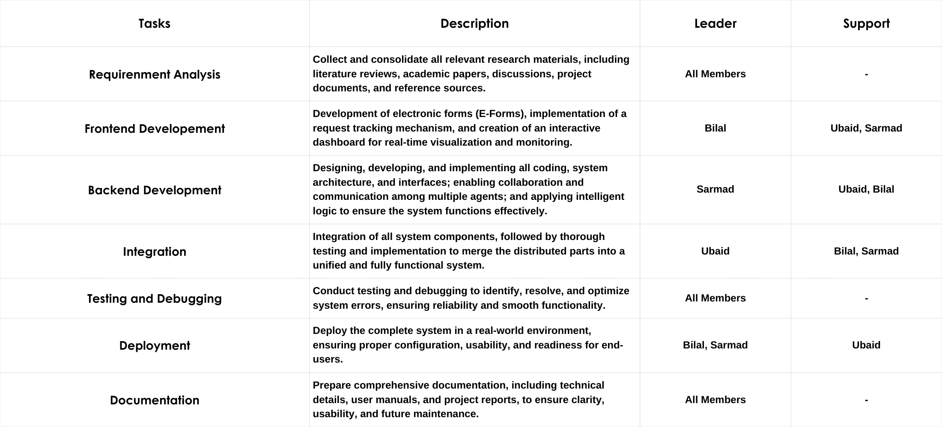
Team Work

Slide 11
References
https://www.researchgate.net/profile/Anoop-Namboodiri/publication/226300537_Document_Structure_and_Layout_Analysis/links/0f31752d6c55f57255000000/Document-Structure-and-Layout-Analysis.pdf
https://www.wseas.us/e-library/conferences/2007cscc/papers/561-514.pdf
https://link.springer.com/article/10.1007/s43621-025-01198-6?utm_source=chatgpt.com
https://pmc.ncbi.nlm.nih.gov/articles/PMC11126581/?utm_source=chatgpt.com
https://paper.researchbib.com/view/paper/295472

Slide 12
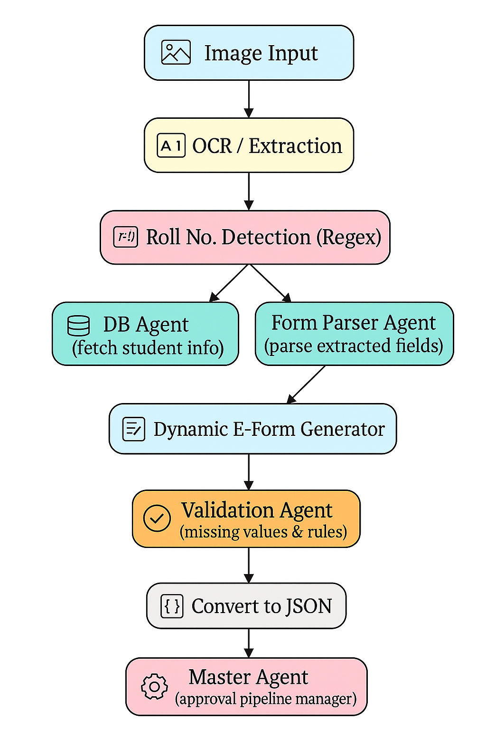
Workflow

